Slide 1

Writing you first Extension

Slide 2

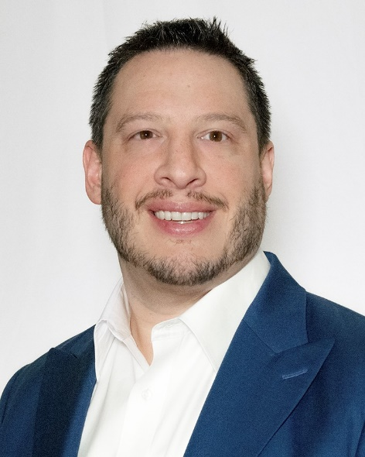

Presenters – Jeff Landeen
Manager at RSM US LLP in Seattle, WA
Bachelor of Mathematics – University of Waterloo
Developed Solutions in both C/AL and AL
Started building reports with Navision 3.10 (in 2002)
Integrated with Zap, Jet and other BI tools
Projects in Canada, Mexico, New Zealand, UK, USA
Focus on Food & Beverage

Slide 3
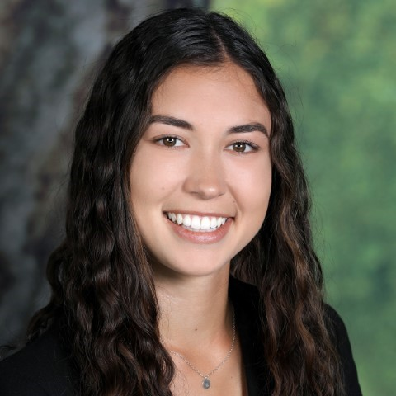

Presenters – Brittany Hodges
Sr. Consultant at RSM US LLP in San Francisco, CA
Bachelor of Science, Business Administration – California Polytechnic State University, San Luis Obispo
Concentration in Accounting and Information Systems
Experience with clients in the Biomedical, Industrial, and Food & Beverage industries
Primary focus on Food & Beverage

Slide 4
Tools you’ll need…
Business Central Instance
SaaS, OnPremise or Docker Image
Visual Studio Code
AL Language Extension
Git or other Source Control
Microsoft Office
Microsoft Report Builder
Github (or other source control)
Notes:
There’s a lot to cover, make sure to jump right in
Github is where a lot of the content from Microsoft is being shared and managed

Slide 5
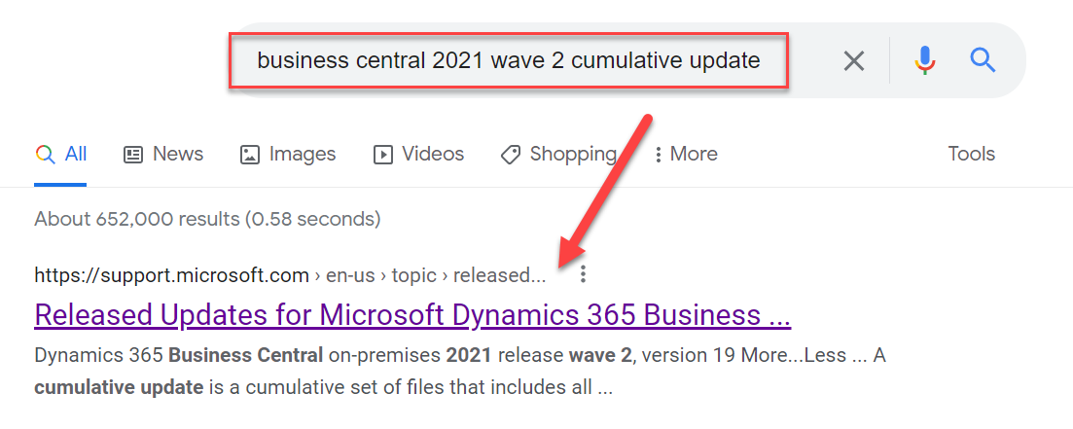
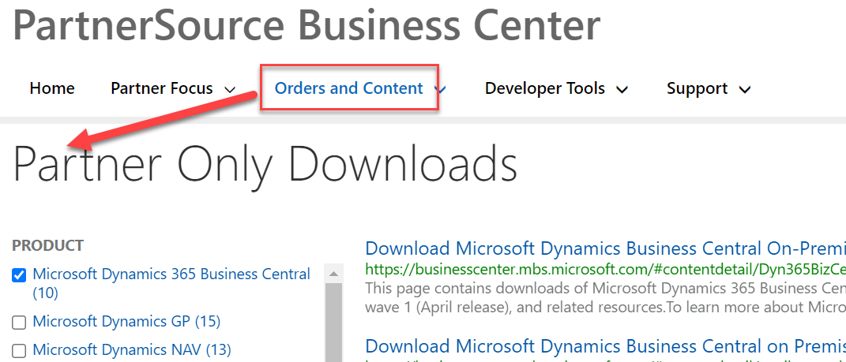
How do I get BC?
Partner Source/MS Support
Partner Source/MS Support
https://dynamics.microsoft.com/en-us/business-central (Saas)

Slide 6
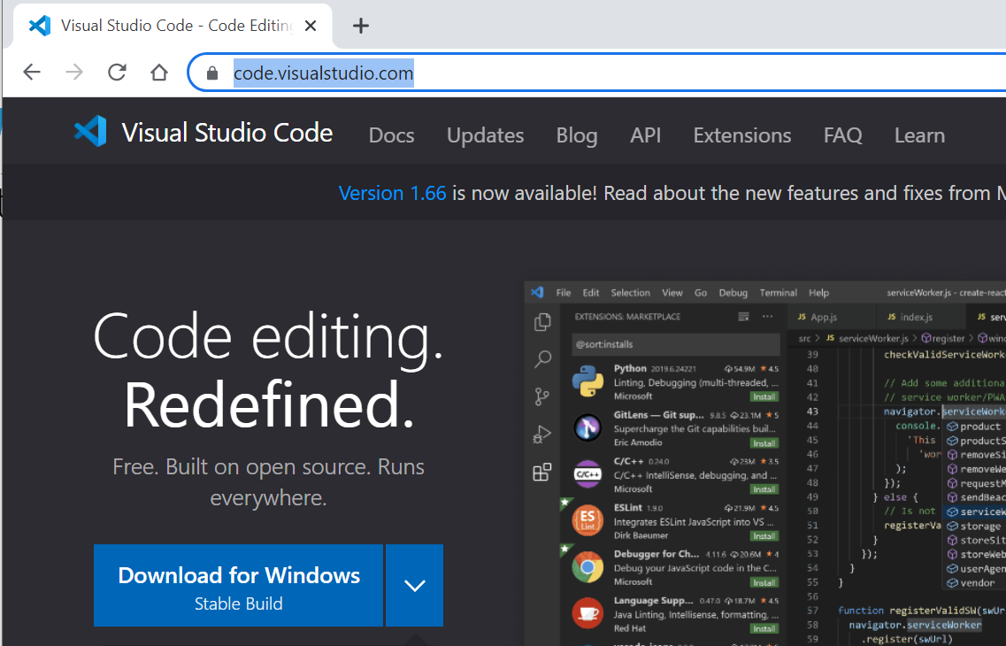
Visual Studio Code
https://code.visualstudio.com/
Notes:
Key point
You can run this on a Mac or on a PC
You can build and publish extensions on a Mac

Slide 7
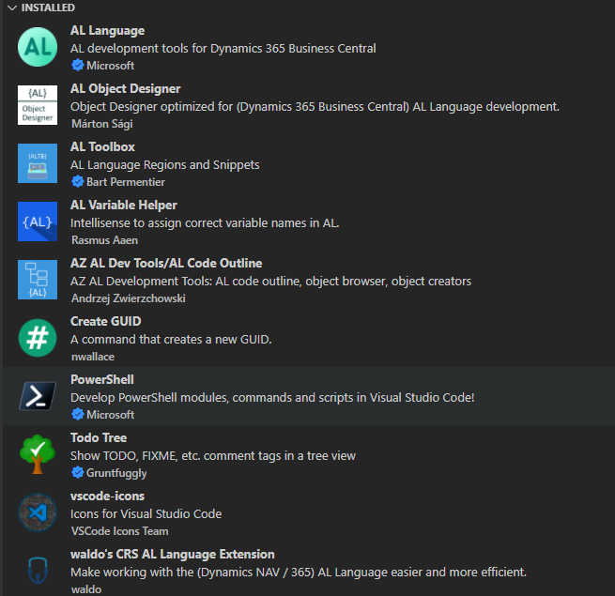
Extend VS Code to extend BC
AL Language
AL Object Designer
Waldos CRS AL Extension
AZ AL Dev Tools
Notes:
- AL Language is one of the first extensions that you’ll need to install

Slide 8
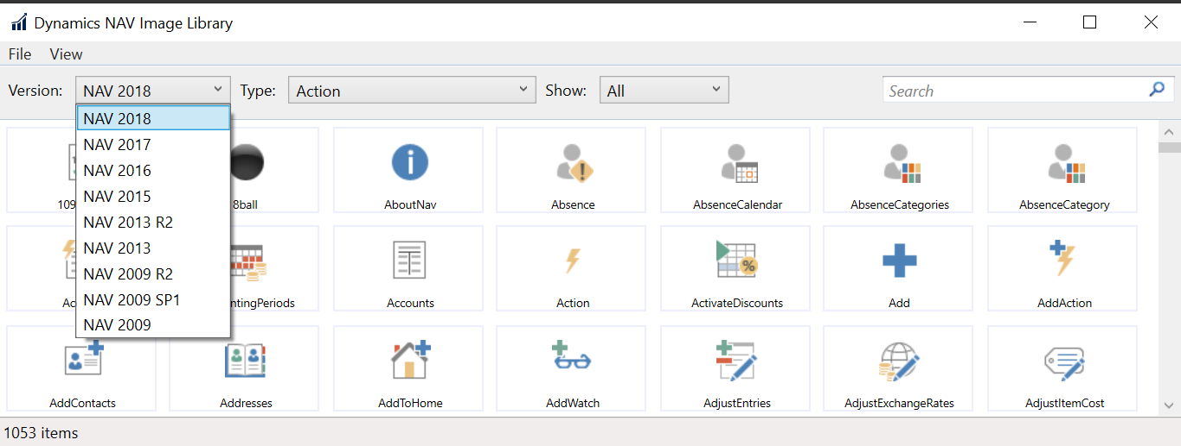
Another Useful Tool
Dynamics NAV Action Image Library
https://mibuso.com/downloads/dynamics-nav-image-library
Notes:
Why is this important
There isn’t great documentation on the images on MS web site
The UI for what is available is not great

Slide 9
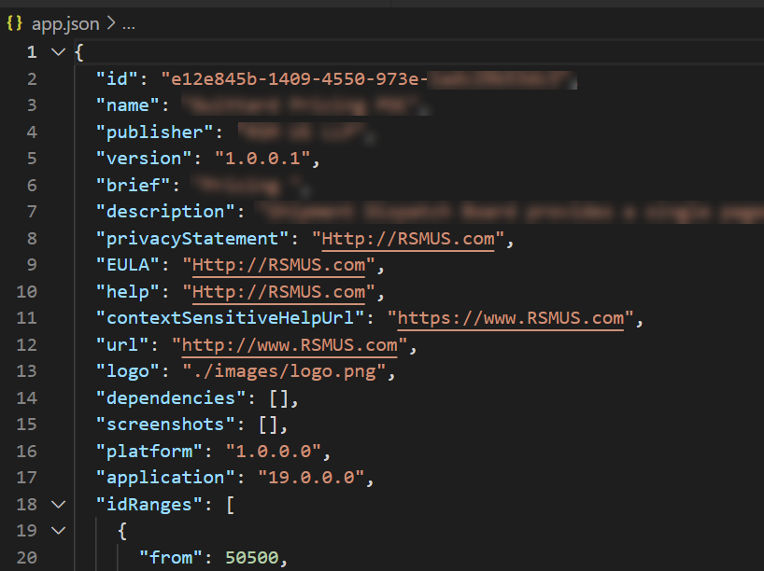
Define your solution – app.json
id
name
publisher
version
dependencies
platform/application
idRanges
Notes:
Key: describes your
Id – this is the main guid that identifies the solution to BC
Name – name of the extension
Publisher – this is the author/owner of the extension
Version – identifies the build of the extension
There can be restrictions on version
Once an extension has been published to SaaS you cannot deploy an older version of the extension (this restriction is moot on premise)
These are the key data elements that you would use to install, publish, unpublish the extension via powershell

Slide 10
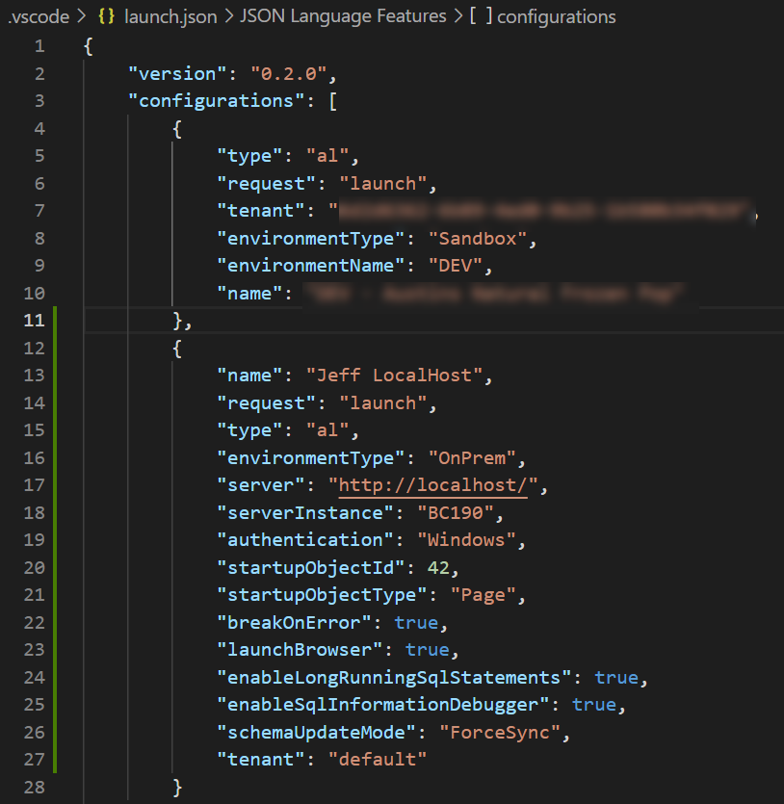
Build and run solution – launch.json
request
type
environmentType
environmentName
tenant (for SaaS)
server & serverInstance (On Prem)
startupObjectId & Type
schemaUpdateMode
Notes:
Request will usually be launch, can also be attach (to debug)
Saas – need tenant, environment type and name
OnPrem – need Server and instance
SchemaUpdateMode can be used to force in breaking changes

Slide 11
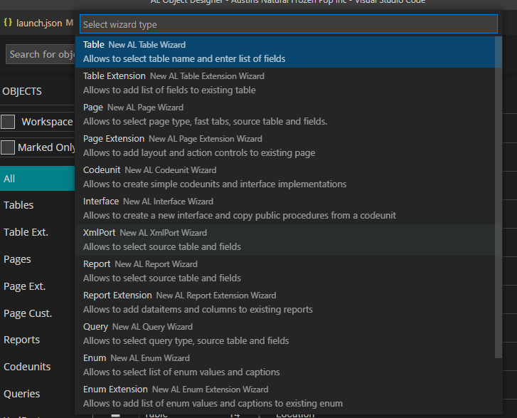
What are the object types?
Tables (data & functions on data)
Pages (access data)
Reports (process or display data)
Codeunits
“Extension” versions of above
Enum
Notes:
Business Central is an object based system
Uses the “AL” language
This is a direvative of the C/AL
Using the Object Wizard
This is a good tool to help quickly build out objects
Some Legacy C/AL type functionality

Slide 12
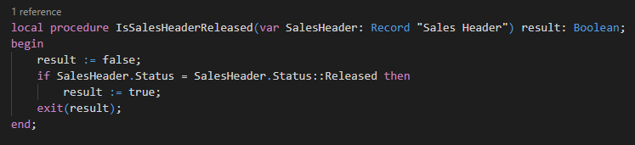
Coding Style
Write readable code
Keep functions close to data
Add meaningful tool tips
Use Action Images

Slide 13
Creating an extension
Customer Requirement:
We need to track a SCAC Code on a Sales Order
This SCAC Code should be copied from the shipping agent to the order on release
Notes:
SCAC Code is from National Motor Freight Traffic Association (i.e. trucking companies) and stands for Standard Carrier Alpha Code
Uniquely identifies trucking and freight companies from one another
Includes

Slide 14

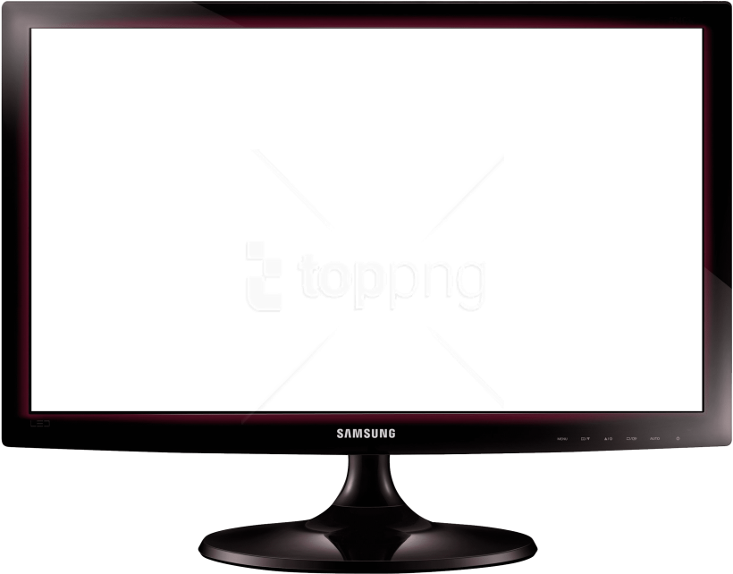
Demonstration
Demonstration
Driver Pick Up Extension
Notes:
Modify the layout of existing Standard Sales Order Confirmation (1305)
Extend Standard Sales Order Confirmation
Add Shipping handling field
Goal – Add a new Driver Pick Up Time
Driver Pick Up Name
Driver Pick Up Email
Add these fields to the Sales Order (table & page)
Add them to the Sales Order Confirmation (Report Extension)

Slide 15
If you have questions….
Microsoft Documentation: https://docs.microsoft.com/en-us/dynamics365/business-central/dev-itpro/developer/devenv-dev-overview
Design Patterns: https://alguidelines.dev/
Reach out: jeff.landeen@rsmus.com
Microsoft MVPs:
Erik Hougaard (https://www.hougaard.com/)
Freddy K (https://freddysblog.com/)
Stefano Demiliani (https://demiliani.com/)
Notes:
Design Patterns is a community driven project has some good patterns to follow (similar to previous coding style guide for NAV)
Erik provides great examples and coding tips (plus some NAV history)
Freddy Kristiensens has posted a lot about Docker and the BC powershell tools for containers
Stefano has some great posts on architecture, performance and interfaces

Slide 16
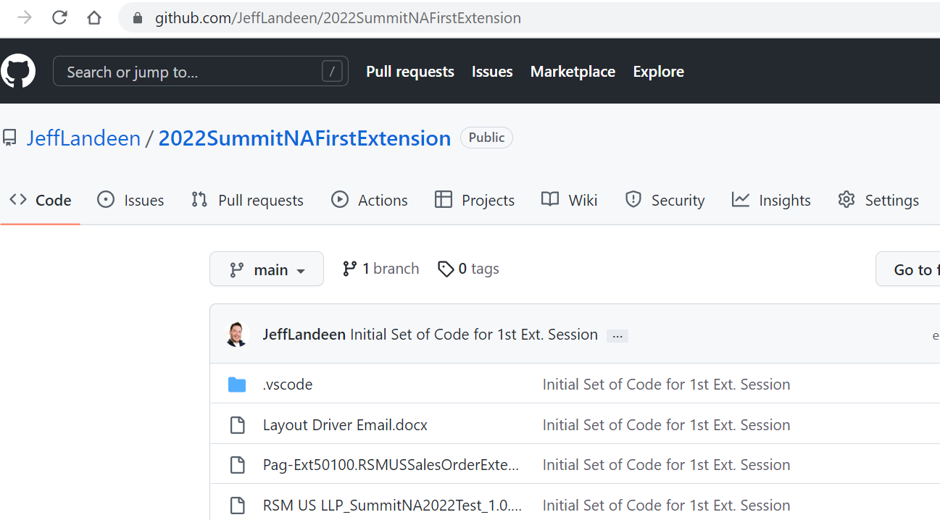
Example Code for this Session:
https://github.com/JeffLandeen/2022SummitNAFirstExtension
Notes:
Design Patterns is a community driven project has some good patterns to follow (similar to previous coding style guide for NAV)
Erik provides great examples and coding tips (plus some NAV history)
Freddy Kristiensens has posted a lot about Docker and the BC powershell tools for containers
Stefano has some great posts on architecture, performance and interfaces

Slide 17
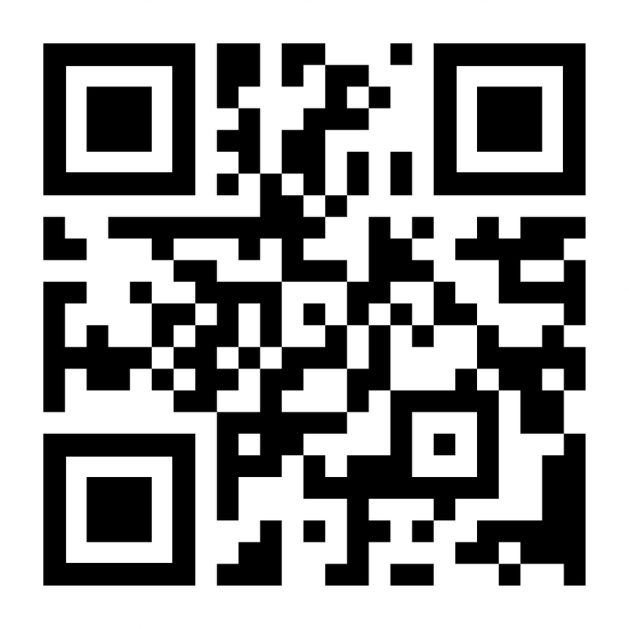
Please Fill Out Session Survey

Slide 18
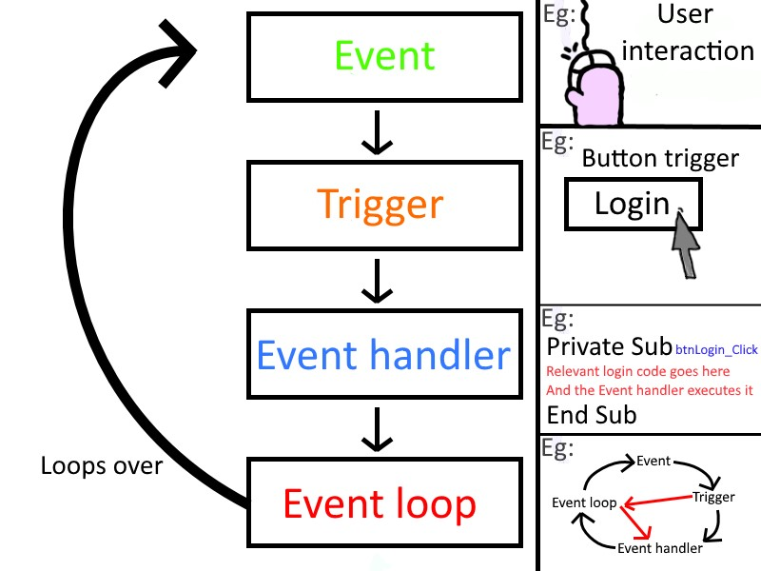
What is an event…and why does it matter?
From: https://commons.wikimedia.org/wiki/File:Event_driven_programming_Simply_Explained.jpg
Notes:
Event driven programming is a key point in extending the base app
Business Central can publish events, extension can subscribe to them

Slide 19
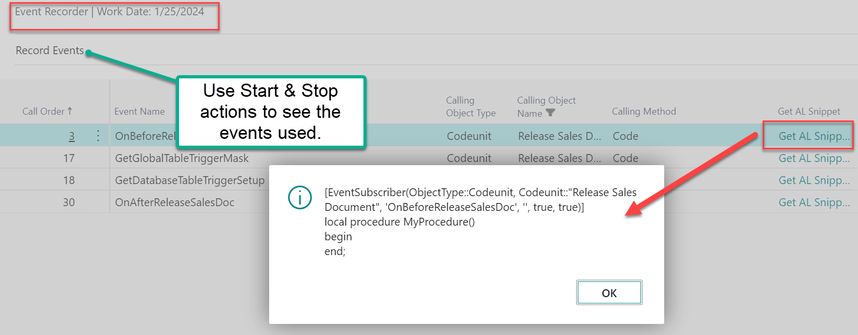
How to find an event?
Notes:
- Use global search in BC for ‘Event Recorder’

Slide 20
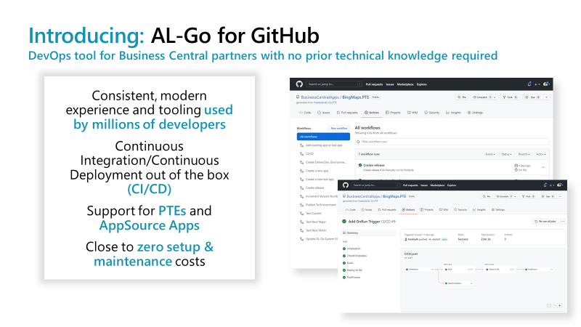
AL Go for GitHub
https://github.com/microsoft/AL-Go (aka.ms/AL-Go)
Notes:
This is for continuous integration & deployment
Important for the SaaS world and constant base app releases & testing
If too advanced AT LEAST USE Source Control

Slide 21
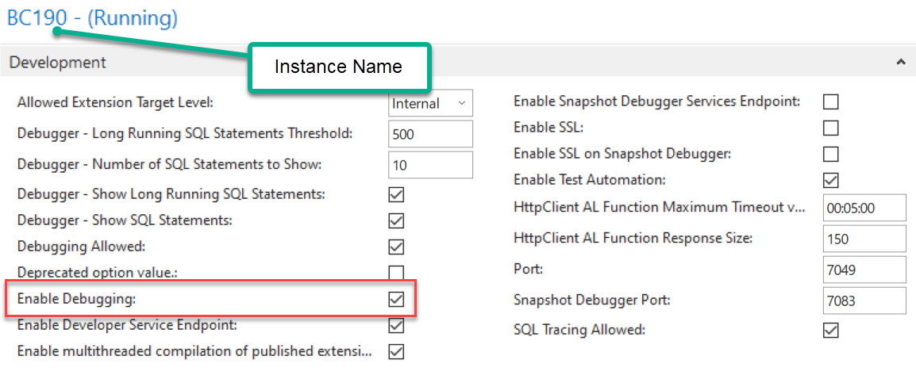
Develop OnPrem – Step 1…turn it on
Notes:
Run the Admin Console
Enable the

Slide 22
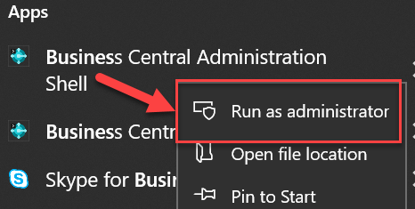

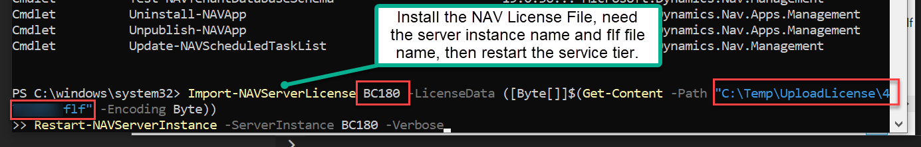
Develop OnPrem – Step 2…install the license
Notes:
Run the BC Admin Shell (must run this as administrator)
Use Import-NAVServerLicense to load the *.flf file
Make sure to restart the server with Restart-NAVServerInstance

Slide 23
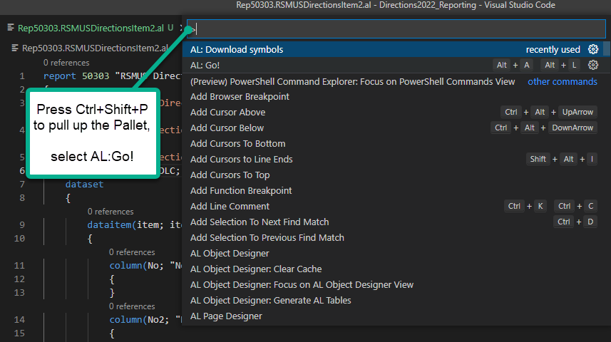
Start a new extension…

Slide 24
How to find an event?
Notes:
- Use the event user

Slide 25
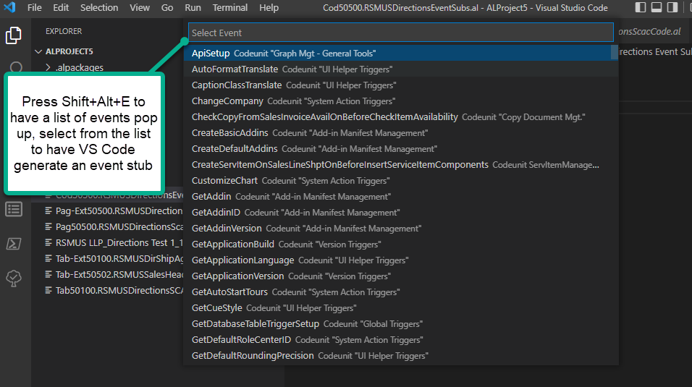
Subscribe to an event
Notes:
- Use the event list to automatically create an event subscriber

Slide 26
Key shortcuts in VS Code
Ctrl+Shift+B = Compile the objects (will create place holder report layouts)
Ctrl+Shift+P = Open command pallet
Can then select ‘AL:Go!’or ‘AL:Download Symbols’
Alt+Shift+E = Open Event List
Use this to insert Event subscribers into a codeunit
F5 = Run with Debbuger
Will compile your solution, publish it to server, hook up debugging session
Ctrl+F5 = Run (no Debugger)
Will compile your solution and publish to server (but will NOT hook up debugger)
Notes:
Design Patterns is a community driven project has some good patterns to follow (similar to previous coding style guide for NAV)
Erik provides great examples and coding tips (plus some NAV history)
Freddy Kristiensens has posted a lot about Docker and the BC powershell tools for containers
Stefano has some great posts on architecture, performance and interfaces

